Slide 1


Slide 2

Contemporary
Management
of Glioblastoma
Notes:
2

Slide 3
Incidence Rates of Primary Brain Tumors Central Brain Tumor Registry of the United States, 1992-1997
100
Number of Cases per 100,000 Population
10
Glioblastoma
Astrocytoma
1
Oligodendroglioma
x
Meningioma
x
Mixed glioma
x
I
x
x
x
x
I
I
x
x
I
Ependymoma
I
I
x
x
I
I
x
x
Medulloblastoma/embryonal/primitive
x
I
Pilocytic astrocytoma
0.1
x
All Brain Tumors
x
0.01
0-19
20-34
35-44
45-54
55-64
65-74
75-84
85+
Age Group
Wrensch M, et al. Neuro Oncol. 2002;4(4):278-299.
Notes:
Incidence of primary brain tumors
X axis is for age
Y axis is the incidence (number of cases per 100,000/population)
Glioblastoma effects multiple age groups! Illustrated by the yellow arrow
Many of us treat patients in the younger group as well as the older group
The average age at diagnosis will continue to rise with time so that eventually the average age at diagnosis will be in the 70s

Slide 4

WHO Classification
GRADE I - "BENIGN" or low-grade
GRADE II - "BENIGN" or low-grade (more diffuse)
GRADE III - ANAPLASTIC (cellular atypia, etc)
GRADE IV - MALIGNANT (necrosis, vascularity, mitoses)
Louis DN, et al. Acta Neuropathol. 2007;114(2):97-109.
Notes:
WHO classification – published in 2007 and new one is coming soon
Brain cancer is not staged like other cancers but focus is on Grade rather than Stage
Brain tumors are not staged because they do not metastasize to other areas of the body
Worst prognosis is Grade IIIs/IVs

Slide 5
High-Grade Malignant Gliomas
Fibrillary astrocytomas
Glioblastoma (WHO grade IV)
*Giant-cell glioblastoma
Anaplastic astrocytomas (WHO grade III)
**Gemistocytic astrocytomas
Oligodendrogliomas
Anaplastic oligodendrogliomas (or Smith classification grade C or D)
Mixed anaplastic oligoastrocytomas
Anaplastic mixed gangliogliomas (mixed neuronal-glial tumors)
*Giant-cell glioblastoma = slower progression rate; **gemistocytic astrocytomas = grade II but acts like grade III
Stupp R, et al. Ann Oncol. 2010;21(Suppl.5):v190-193.
Notes:
Multiple subtypes – tumor comes from glial cells – making them hard to surgically removed because the fingers extend to other areas of the brain
Higher grade to lower grade tumors

Slide 6
Why Is It So Difficult to Treat Malignant Gliomas?
Multiple disordered pathways (ie, AKT, IGF, HGF, etc)
Multiple mutated targets (ie, EGF, PDGF, VEGF, etc)
Poor disease biomarker
Blood brain barrier
Limited therapeutic window (Central nervous system is very sensitive to insults)
Rapid development of resistant disease
Notes:
Why is it so difficult to treat malignant gliomas?
Infiltrating tumors difficult to treat
They have multiple disordered pathways
Multiple mutated targets for this disease
Blood brain barrier a challenge as well as the fact that there are no disease biomarkers

Slide 7
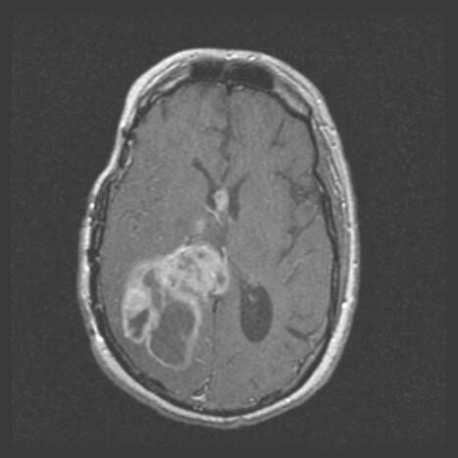
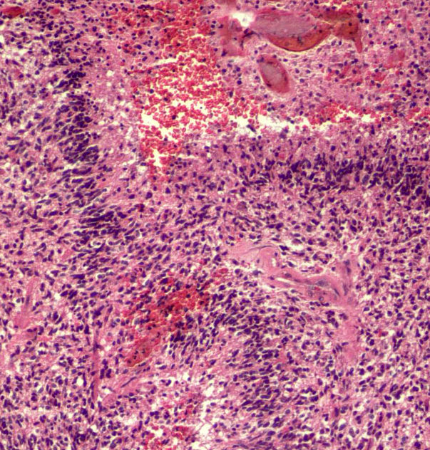
Glioblastoma (WHO IV)
T1 + gad
H&E
Enhancing cystic with necrosis
Enhancing cystic with necrosis cellular, vessels, necrosis, MIB-1
Notes:
WHO classified stage IV
Radiographic slide on the left shows a very fast growing tumor with necrosis
Any time you see a pathology slide such as one on the right – indicates bad disease
Lots of different changes seen all over the screen

Slide 8
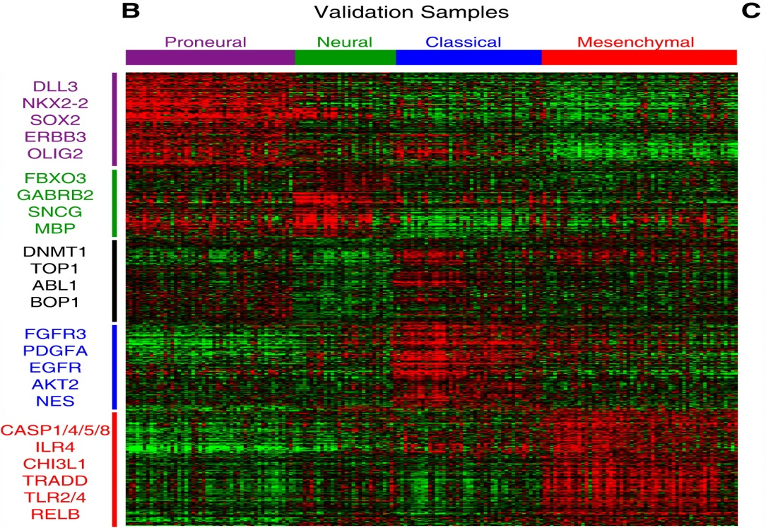
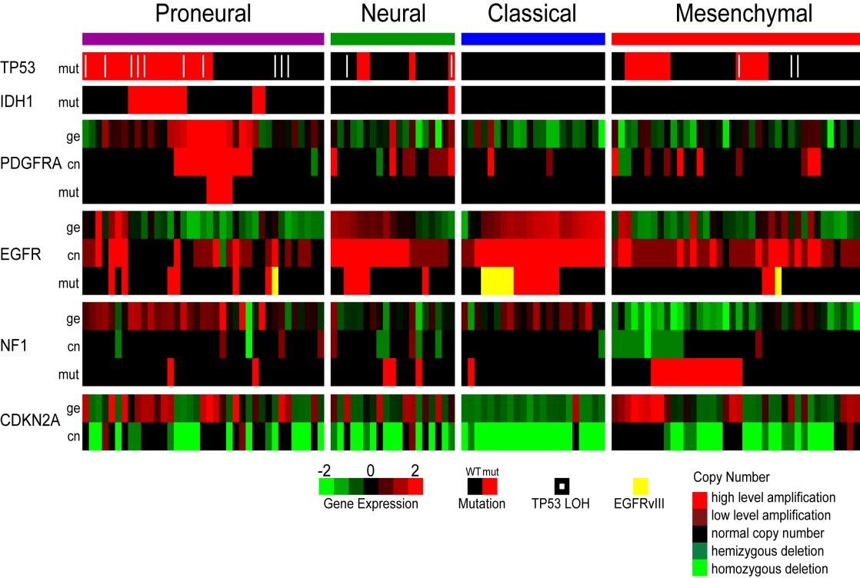
At Least Four Molecular Subtypes of Glioblastomas (Secondary Glioblastomas Have Proneural Profile)
Verhaak RG, et al. Cancer Cell. 2010;17(1):98-110.
Notes:
This slide shows how we subtype this disease and it is very heterogeneous
We talk about it as one disease but in fact it has similarities to breast cancer

Slide 9
FDA-Approved Treatments for Malignant Glioma
June 14, 1996: Carmustine wafer for recurrent glioblastoma
January 12, 1999: Temozolomide (TMZ) for anaplastic astrocytoma
February 25, 2003: Carmustine wafer for newly-diagnosed glioblastoma
March 15, 2005: Temozolomide for newly-diagnosed glioblastoma
May 5, 2009: Bevacizumab (BEV) for progressive glioblastoma
April 15, 2011: NovoTTF-100A for recurrent glioblastoma
Notes:
Timeline for approved treatments – shows the slow progress in new approved agents for this disease

Slide 10
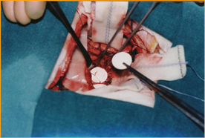
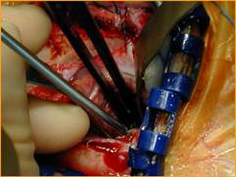
Surgical Implantation of Chemotherapy Wafers: Carmustine
Notes:
Carmustine wafer “an alkylating agent” is inserted into brain cavity after surgical removal of the brain tumor.
Wafer allows for delivery of the drug directly to the site of the brain tumor

Slide 11
Carmustine Wafer for Newly Diagnosed Glioblastoma
100 –
90 –
80 –
70 –
60 –
50 –
40 –
30 –
20 –
10 –
0 –
Hazard ratio (HR): 0.71
95% CI: 0.52-0.96
Risk reduction: 29%
P = .03
Survival Rate, %
Carmustine wafer
Median survival, months
Months From Implant Surgery
Carmustine 13.9
Placebo 11.6
Placebo
0 2 4 6 8 10 12 14 16 18 20 22 24 26
Westphal M, et al. Neuro Oncol. 2003;5(2):79-88.
Notes:
Survival rate shown for Carmustine wafer in newly diagnosed glioblastoma
Rarely used now but still an option for some patients

Slide 12
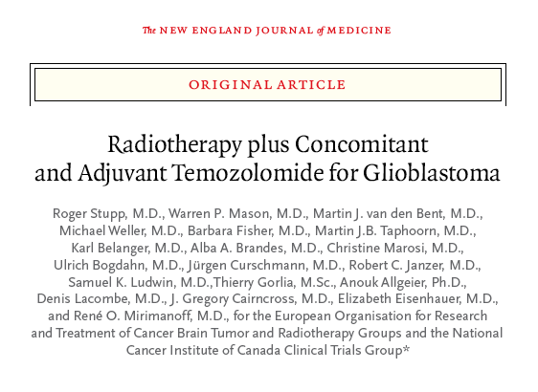
Adjuvant Temozolomide Improves Survival in Glioblastoma
Stupp R, et al. N Engl J Med. 2005;352(10):987-996.
Notes:
This is the ground breaking paper by Dr Roger Stupp showing the improvement in survival for these patients with use of temozolomide

Slide 13
Treatment Schema
Concomitant TMZ/RT*
Adjuvant TMZ
R
0 6 10 14 18 22 26 30 Weeks
RT alone
Temozolomide 75 mg/m² po qd for 6 weeks, then 150 to 200 mg/m² po qd 1 to 5 every 28 days for 6 cycles
Focal RT daily-30 x 200 cGy
Total dose 60 Gy
*PCP prophylaxis was required for patients receiving TMZ during the concomitant phase. RT, radiotherapy
Stupp R, et al. N Engl J Med. 2005;352(10):987-996.
Notes:
This slide shows the treatment schema for the trial and most physicians today continue with adjuvant temozolomide if the patient is stable
Total dose of radiation was 60Gy

Slide 14
Radiotherapy and Temozolomide for Newly Diagnosed Glioblastoma
573 randomly assigned
286 allocated to radiotherapy
287 allocated to radiotherapy and temozolomide
7 did not start treatment
5 refused
1 early progression
1 systemic air embolism (lung)
3 did not start treatment
2 refused
1 wrong diagnosis
14 discontinued radiotherapy
4 progressive disease
7 acute toxicity
1 family decision
1 second surgery
1 protocol violation
37 discontinued temozolomide
5 progressive disease
7 hematotoxicity
10 nonhematotoxicity
2 both toxicities
10 administrative failure
1 repeat surgery
19 discontinued treatment
7 progressive disease
10 acute toxicity
2 early death
1 received concurrent temozolomide
286 in intent-to-treat (ITT) efficacy analysis
279 in safety analysis
287 in ITT efficacy analysis
284 in safety analysis
Stupp R, et al. Lancet Oncol. 2009;10(5):459-466.
Notes:
This was a decent size clinical trial for this group of patients (N=573)
Study was evenly distributed between both groups either radiation alone or radiation and temozolomide
treatment was well tolerated

Slide 15
Radiotherapy and Temozolomide for Newly Diagnosed Glioblastoma
100 –
90 –
80 –
70 –
60 –
50 –
40 –
30 –
20 –
10 –
0 –
Combined
Radiotherapy
P<.0001
Survival, %
n = 287
n = 286
0 1 2 3 4 5 6 7
Time, Years
Number at risk
Combined
Radiotherapy
254 175 76 39 23 14 6
278 144 31 11 6 3 0
Stupp R, et al. Lancet Oncol. 2009;10(5):459-466.
Notes:
This is the curve that changed neurooncology
Shows a statistically significant difference in survival for the group that was treated with RT and temozolomide versus RT alone

Slide 16
MGMT Promoter Methylation Is Associated With Improved Survival in Patients Treated With RT+TMZ
Unmethylated MGMT
Methylated MGMT
RT RT + TMZ
Median OS, months 11.8 12.7
2-year survival, % 1.9 13.8
RT RT + TMZ
Median OS, months 15.3 21.7
2-year survival, % 22.7 46.0
100
100
90
90
80
Log-rank: P = .062
80
Log-rank: P = .0074
70
70
Overall Survival (OS), %
60
RT + TMZ
60
50
50
40
40
30
RT + TMZ
30
RT alone
RT alone
20
20
10
10
0
0
0
4
8
12
16
20
24
28
32
36
40
0
5
10
15
20
25
30
35
40
Time, months
Time, months
Hegi ME, et al. N Engl J Med. 2005;352(10):997-1003.
Notes:
Companion pager by Hegi with the same group of patients
The 2 curves show survival based MGMT methylation status . This allows you to counsel your patients (will still administer temozolomide if patient is fit) and guides your treatment in recurrence
The curves on the right show a median in OS of 21.7 months for the patients receiving the combined treatment with methylated MGMT
Compare with the unmethylated MGMT patients in the curves on the left who only had a median OS of 12.7 months in the combined group
This represents another option we use to evaluate our patients in addition to imaging, and can use as a guide for treatment

Slide 17
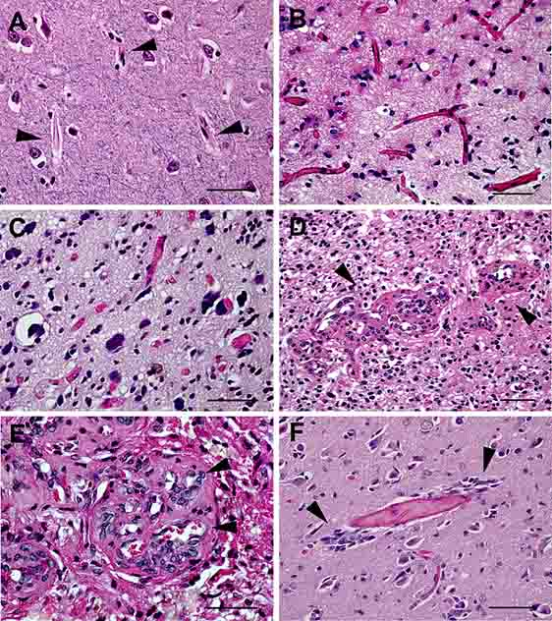
Malignant Gliomas Generate
Abnormal Blood Vessels
Normal human cortex
Stiver SI. Front Biosci. 2004;9:3105-3123.
Notes:
This slide shows how gliomas generate abnormal vasculature
17

Slide 18
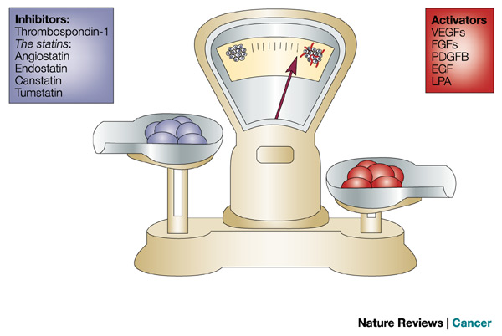
Angiogenesis Balance
Bergers G, et al. Nat Rev Cancer. 2003;3(6):401-410.
Notes:
Slide shows a simplified version of inhibitors and activators
A lot of research using VEGF inhibitors in this disease has fallen flat

Slide 19
Glioblastoma Has the Greatest Potential for Angiogenesis
Endothelial Dependency
Glioblastoma
Adenocarcinoma
Sarcoma
Chondrosarcoma
Endothelial-
poor tumors
Endothelial-
rich tumors
M.A.G. Score
Brem S, et al. J Natl Cancer Inst. 1972;48(2):347-356.
Notes:
Stepping stone for the angiogenesis model
Take home message – GBMs have endothelium that can be targeted

Slide 20
VEGF mRNA Is Upregulated in the Hypoxic Zone of Glioblastomas
Plate KH, et al. Nature. 1992;359(6398):845-848.
Notes:
Illustration of slides shown from left to right of VEGF being unregulated – evidence that there was a target to be pursued
Please notice this paper was published in 1992

Slide 21
Anti-Angiogenic Therapy in Malignant Glioma
First generation angiogenesis inhibitors:
Thalidomide
Lenalidomide
Penicillamine
Carboxyamidotriazole
Small-molecule inhibitors of VEGRF/PDGFR/EGFR:
Cediranib (AZD 2171)
Vatalanib (PTK 787)
Pazopanib (GW 786034)
Sorafenib
Sunitinib
Vandetanib (ZD 6474)
Metronomic temozolomide
Inhibitors of VEGF
Bevacizumab
Notes:
Grid of all the treatments that have been tried
Nothing has been impactful for changing this field

Slide 22
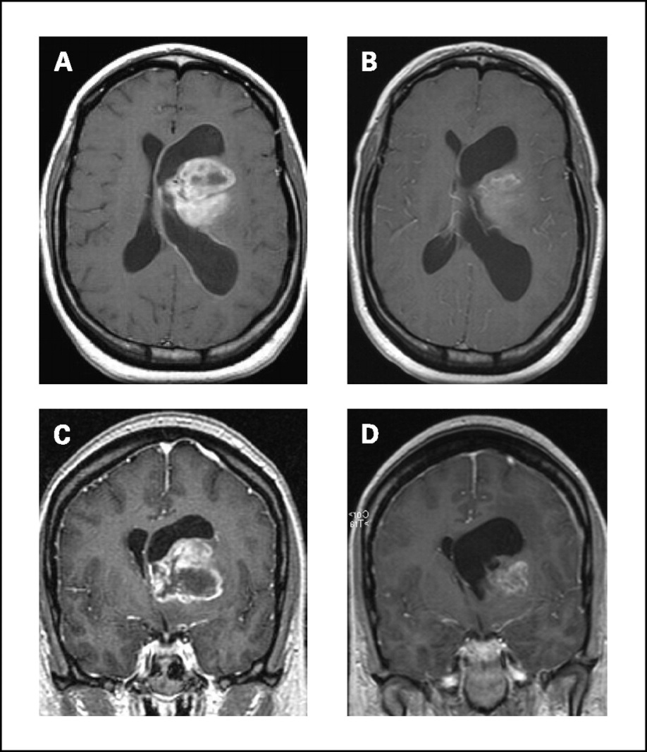
High Response Rate and Improved Progression-Free Survival (PFS) in Phase II Trial of Bevacizumab and Irinotecan
1.0
Progression-Free Survival Probability
0.8
0.6
Non GBM
n = 9
0.4
GBM
n = 23
0.2
0.0
0
10
20
30
40
50
Time, Weeks
Glioblastoma (GBM) PFS-6 (30%) = 20 weeks (9 weeks hc)
Anaplastic glioma PFS-6 (56%) = 30 weeks (13 weeks hc)
Vredenburgh JJ, et al. Clin Cancer Res. 2007;13(4):1253-1259.
Notes:
Surprise findings – improved survival and symptoms (significant quality of life improvement)
False picture because the tumor was still there
The 6-month PFS was 38% (95% CI, 24-59%) for the entire group of patients.
As expected, the 6-month PFS was better in the WHO grade III glioma patients, 56% (95% CI, 31-99%) versus 30% (95% CI, 16-57%) for the WHO grade IV glioma patients.
The median PFS was 23 weeks (95% CI, 15-30 weeks), with a range of 6 to 46+ weeks.
The median PFS was 20 weeks in grade IV patients and 30 weeks in grade III patients
The 6-month overall survival is 72% (95% CI, 58-89%). The median OS is 40 weeks in Grade IV patients

Slide 23
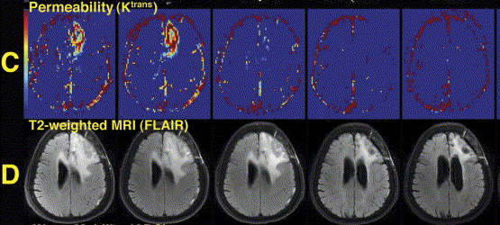
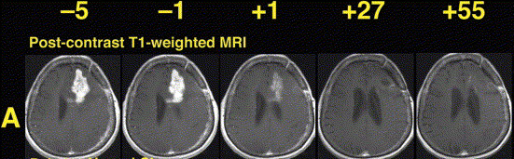
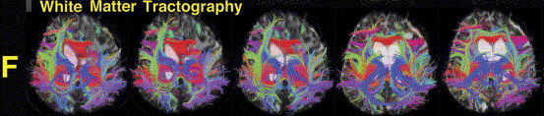
AZD2171 (cediranib)
(pan-VEGFR inhibitor)
Responder
Batchelor TT, et al. Proc Natl Acad Sci U S A. 2013;110(47):19059-19064. Batchelor TT, et al. J Clin Oncol. 2013;31(26):3212-3218.
Notes:
This pan-VEGFR inhibitor drug was initially positive in 2013, but the final results of the trial were unfortunately negative

Slide 24
Bevacizumab Plus Irinotecan Versus Salvage Cytotoxic Chemotherapies
 | PFS, 6 months | Response
Bevacizumab plus irinotecan
Vredenburgh, et al | 57% | 46%
Chen, et al | 47% | 65%
*Friedman HS, et al | 38% | 50%
*Kreisl TN, et al | 35% | 29%
**Wong, et al - cytotoxic chemotherapy | 6% | 15%
Vredenburgh JJ, et al. J Clin Oncol. 2007;25(30):4722-4729. Chen W, et al. J Clin Oncol. 2007;25(30):4714-4721. *FDA approval: Friedman HS, et al. J Clin Oncol. 2009;27(28):4733-4740. Kreisl TN, et al. J Clin Oncol. 2009;27(5):740-745.
**Wong ET, et al. J Clin Oncol. 1999;17(8):2572-2578.
Notes:
The 6 months PFS numbers for each study vary so much – causing you again to counsel the patients regarding the toxicity & side effects of irinotecan without the benefit
Response rates are all over the place
FDA approved bevacizumab based on the results of PFS improvement

Slide 25
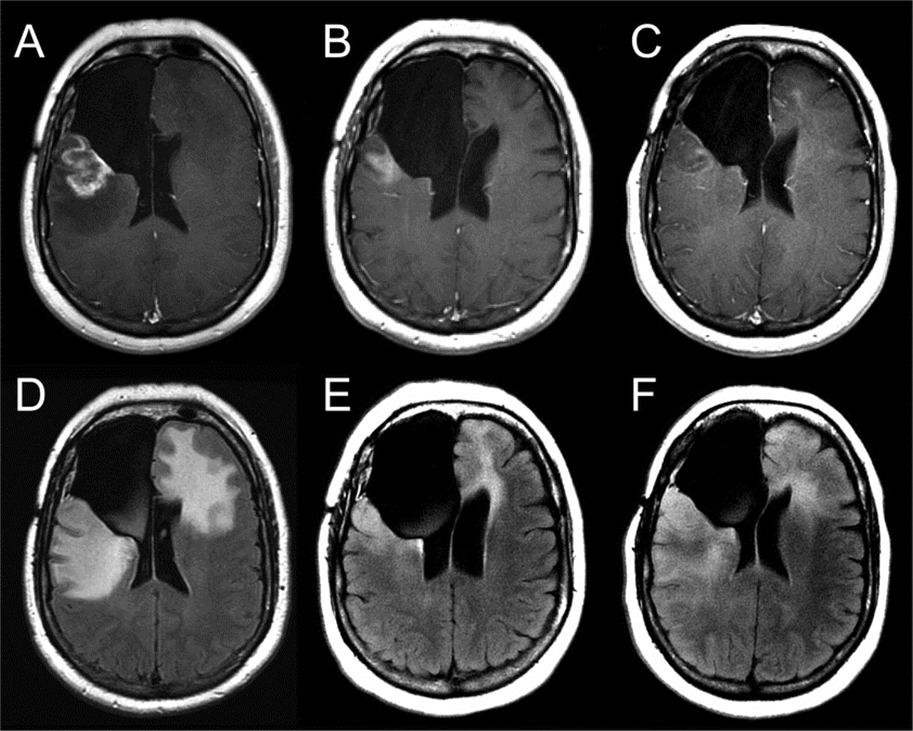
Tumor Progression During
Bevacizumab Plus Irinotecan
Norden AD, et al. Neurology. 2008;70(10):779-787.
Notes:
Slide shows tumor progression
Counsel patients based on results

Slide 26
Bevacizumab for Newly Diagnosed Glioblastoma
RTOG 0825: Phase III trial testing first-line treatment with bevacizumab
Clinical stratification
factor
Arm A
60 Gy + daily TMZ (75 mg/m²qd) + placebo q 2 weeks
TMZ (150-200 mg/m²) d 1-5 q28d X 12 C + placebo q 2 weeks
R
E
G
I
S
T
E
R
R
ANDOM
I
Z
E
Eligible
GBM
KPS ≥70
Age ≥18
Tissue +
Stratify
RPA class
MGMT
Status
molecular profile
RT (30 Gy)
TMZ (75 mg/m²/d)
MGMT & molecular
profile analysis
Arm B
60 Gy + daily TMZ (75 mg/m²qd) + BEV (10 mg/m² q 2 weeks)
TMZ (150-200 mg/m²) d 1-5 q28d X 12 C + BEV (10 mg/m² q 2 weeks)
Molecular
stratification
factor
9 gene assay
-Prognostic
-?Predictive
Gilbert M, et al. J Clin Oncol. 2013;31(suppl): Abstract 01.
Notes:
After the approval of bevacizumab for recurrent glioblastoma in 2009 the FDA required 2 large randomized phase III studies to be conducted in newly diagnosed glioblastoma and this is one of them
RTOG 0825 – Phase III for 1st line treatment with bevacizumab (lead by Mark Gilbert)
Here you see the arms of the study
Randomized to standard of care or the second arm added bevacizumab once the patient had received 3 weeks of radiation

Slide 27
Bevacizumab for Newly Diagnosed Glioblastoma
Primary outcomes by treatment
100
Progression-free Survival, %
100
Overall Survival, %
75
75
50
50
25
25
placebo
bevacizumab
Dead
198
215
Total
309
312
P = .21
HR (95% CI) = 1.13 (0.93, 1.37)
placebo
bevacizumab
Failed
256
256
Total
309
311
P = .007
HR (95% CI) = .79 (0.66, 0.94)
0
0
6
12
18
24
30
0
0
6
12
18
24
30
Patients at risk
placebo
bevacizumab
Months After Randomization
Patients at risk
placebo
bevacizumab
Months After Randomization
309
312
255
263
192
200
112
99
50
47
22
17
309
311
163
241
96
133
54
59
27
17
12
8
Median overall survival
Placebo: 16.1 months
Bevacizumab: 15.7 months
HR (BEV/placebo: 1.13 [95%CI: 0.93, 1.37])
P = .21
Median progression-free survival
Placebo: 7.3 months
Bevacizumab: 10.7 months
HR (BEV/placebo: 0.79 [95%CI: 0.66, 0.94])
P = .007
Neither OS or PFS achieved prespecified endpoints
Gilbert M, et al. J Clin Oncol. 2013;31(suppl): Abstract 01. Gilbert M, et al. Presented at: 2013 Scientific Meeting and Education Day of the Society for Neuro-Oncology; November 21-24, 2013; San Francisco, California: Abstract NO-046.
Notes:
Dr Mark Gilbert had the honor of presenting this double-blind placebo controlled study during the plenary session at 2013 ASCO annual meeting in Chicago
OS & PFS curves did not achieve the prespecified endpoints – people considered this information conflicting, confusing, and disappointing

Slide 28
Bevacizumab for Newly Diagnosed Glioblastoma
Outcomes by MGMT status: Both arms pooled
100
Progression-free Survival, %
100
Overall Survival, %
75
75
50
50
25
25
unmethylated
methylated
Dead
84
316
Total
175
429
P < .001
HR (95% CI) = 2.10 (1.65, 2.68)
umethylated
methylated
Failed
125
371
Total
174
429
P = .001
HR (95% CI) = 1.67 (1.36, 2.05)
0
0
6
12
18
24
30
0
0
6
12
18
24
30
Patients at risk
methylated
unmethylated
Months After Randomization
Patients at risk
methylated
unmethylated
Months After Randomization
175
429
149
357
131
253
85
121
37
57
17
22
174
429
130
265
91
134
43
62
18
24
8
12
Median overall survival
Methylated: 23.2 months
Unmethylated: 14.3 months
HR (unmeth/meth: 2.10 (95%CI: 1.65, 2.68)
P<.001
Median progression-free survival
Methylated: 14.1 months
Unmethylated: 8.2 months
HR (unmeth/meth: 1.67 (95%CI: 1.36, 2.05)
P<.001
Gilbert M, et al. J Clin Oncol. 2013;31(suppl): Abstract 01.
Notes:
Outcomes for MBMT mattered and the OS and PFS were statistically significant

Slide 29
Bevacizumab for Newly Diagnosed Glioblastoma
AVAglio study design
RT
2Gy; 5 days/week
TMZ
75mg/m² qd
Placebo
q2w
TMZ
150-200 mg/m² qd days 1-5 q28d
Placebo
q2w
Placebo
q3w
n = 463
Randomization
N = 921
Stratification
∙ RPA class
∙ Region
Debulking surgery or biopsy
RT
2Gy; 5 days/week
TMZ
75mg/m² qd
BEV
10 mg/kg q2w
TMZ
150-200 mg/m² qd days 1-5 q28d
BEV
10 mg/kg q2w
BEV
15 mg/kg q3w
n = 458
Treatment start
4-7 weeks post surgery
Concurrent phase
6 weeks
T x break
4 weeks
Maintenance phase
6 cycles
Monotherapy phase
until PD
Wick W, et al. J Clin Oncol. 2013;31(suppl): Abstract 2002.
Notes:
AVAglio was the international study similar to the RTOG study done in the US but US study had different eligibility criteria
Patients in this study have a Treatment break for 4 weeks followed by a maintenance phase for 6 cycles and a monotherapy phase until PD

Slide 30
Bevacizumab for Newly Diagnosed Glioblastoma
AVAGlio trial: Investigator-assessed PFS (Co-primary endpoint)
RT/TMZ/PIb (n = 463)
RT/TMZ/BEV (n = 458)
1.0
0.9
Probability of PFS
0.8
0.7
Stratified HR: 0.64 (95% CI: 0.55-0.74)
P<.0001 (log-rank test)
0.6
0.5
0.4
0.3
0.2
0.1
0.0
6.2 months
10.6 months
0
3
6
9
12
15
18
21
24
27
30
33
36
Months
N at risk
RT/TMZ/PIb
RT/TMZ/BEV
463
458
349
424
247
366
170
278
110
189
77
104
47
71
23
25
8
13
4
2
0
1
0
0
0
0
Wick W, et al. J Clin Oncol. 2013;31(suppl): Abstract 2002.
Notes:
AVAGlio PFS
This study showed a 4.4 months improvement in PFS - but the curves were still disappointing

Slide 31
Bevacizumab for Newly Diagnosed Glioblastoma
Overall survival (Co-primary endpoint)
 | RT/TMZ/PIb (n = 463) |  | RT/TMZ/BEV (n = 458)
Patients with an event, n | 346 |  | 333
Stratified HR (95% CI) P value (log-rank test) | 0.88 (0.76-1.02) 0.0987
1-year survival rate, % (95% CI) | 66 (62-71) | 72 (68-77)
P value | 0.049
2-year survival rate, % (95% CI) | 30 (26-34) | 34 (29-38)
P value | 0.235
1.0
Probability of Survival
0.9
0.8
0.7
0.6
0.5
0.4
0.3
0.2
0.1
0.0
16.7 months
16.8 months
0
3
6
9
12
15
18
21
24
27
30
33
36
39
42
45
N at risk
RT/TMZ/PIb
RT/TMZ/BEV
Months
463
458
444
440
405
421
355
387
293
322
245
253
201
203
163
176
118
139
84
91
53
61
28
27
15
11
6
4
0
1
0
0
Designed to achieve a HR of 0.80 (20% reduction in the risk of death) with 80% power (log-rank test, 2 sided 4% α level adjusted using O’Brien and Fleming): 683 events were required for analysis
Wick W, et al. J Clin Oncol. 2013;31(suppl): Abstract 2002. Chinot OL, et al. Presented at: 2013 Scientific Meeting and Education Day of the Society for Neuro-Oncology; November 21-24, 2013; San Francisco, California: Abstract NO-031.
Notes:
WHITE curve (Bev arm) is very close to the green curve without bevacizumab
1 year survival rate was 72% and 2-year survival was 34% for the Arm that included bevacizumab

Slide 32
Bevacizumab for Newly Diagnosed Glioblastoma
No clinical benefit in upfront treatment of glioblastoma
Primary endpoints
 | RTOG 0825 |  | AVAGLIO
Regimen | Bevacizumab/TMZ/RT | TMZ/RT | Bevacizumab/TMZ/RT | TMZ/RT
PFS | 10.3 months | 7.3 months | 10.6 months | 6.2 months
 | HR 0.79, P = .07 |  | HR 0.64, P<.0001
OS | 15.7 months | 16.1 months | 16.8 months | 16.7 months
 | HR 1.13, P = .21 |  | HR 0.88, P = .0987
2. There may be benefit in specialized population of patients with newly diagnosed glioblastoma (ie, large unresectable tumor, molecular genetics, etc)
Gilbert M, et al. J Clin Oncol. 2013;31(suppl): Abstract 01. Wick W, et al. J Clin Oncol. 2013;31(suppl): Abstract 2002.
Notes:
Many people say we have 2 trials which show this is NOT the right thing to do for these patients but there may be a benefit in a specialized group of patients and we need a trial for that

Slide 33
Treatment Options for Glioblastoma
Newly-diagnosed:
Maximum safe neurosurgical resection
Radiotherapy with concomitant temozolomide
Adjuvant temozolomide
At recurrence:
Re-resection (Carmustine wafer may be used)
Second-line chemotherapy
NovoTTF
Bevacizumab with or without chemotherapy
Re-irradiation
Notes:
As of today - the best treatment is still surgical resection along with radiation & concomitant temozolomide for the newly diagnosed patient
At recurrence we have multiple options for patients
Need to take time to counsel patients about each of these options

